Slide 1

Web of Trust for Better Privacy Protection in Android Applications
Supervisor: Dr. Kasun de Zoysa

Slide 2
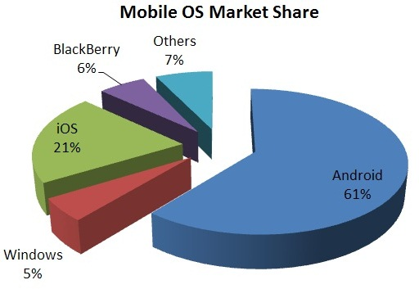
Introduction
Android is the most popular mobile OS
Users can download applications from markets such as Google Play
“Permission” required for apps to access critical resources
Developers should specify which permissions are needed in the Android Manifest- Least Privilege
Users have to approve these permissions for the application to function
Notes:
-Android is the most popular mobile OS with a 29.3% lead over iOS (the next most popular) according to current market research.
-In Android, users can download applications which have been added to markets such as the Google PlayStore by developers. When uploading, developers should specify which critical resources their applications will need access to, called ‘permissions’ in an xml document called the Android Manifest. Principle of Least Privilege is expected to be followed, developers have to specify the minimum needed for the app to function -Users have to approve these permissions for the application to use the related function.

Slide 3
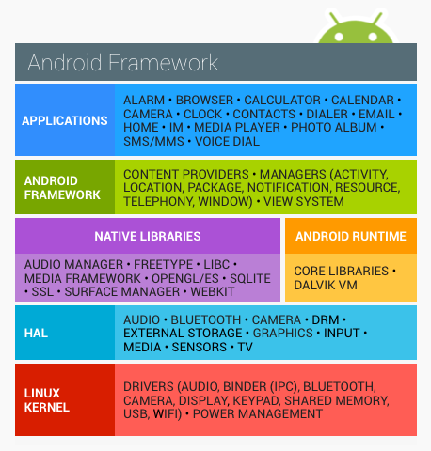
Android Permissions
Each application gets a unique Linux user ID[2]
Permissions assigned for each user ID
User ID consistent for application lifetime on device
Linux UIDs are supposed to provide process isolation[3]
Notes:
-Basically how permissions works is that each application is given a unique user ID to access the Linux kernel on which the entire framework rests
-As seen in the image, the kernel is the bottom-most layer, with the Hardware Abstraction Layer, native libraries, the Dalvik VM, applications framework etc. on top of it) -Kernel is expected to provide a user based permission system with process isolation.
-Android isolates apps from one another and from the system by assigning them a distinct Linux User ID (UID) during the installation process
-UID does not change for the duration of the app’s lifetime on the device. The system maintains a list of UIDs in use, and assigns the next available one to the newly installed app.
-Device rebooting will force the system to reconstruct the UID list, so the UIDs of the uninstalled apps will be recycled and be possibly assigned to the newly installed apps.

Slide 4
Granting Permission – Do or Die
Show list of permissions before installation
Accept or Cancel?
Accept Application will be installed. Permission cannot be revoked.
Cancel installation App will not be installed.
Notes:
-In versions of the SDK older than 23, permissions follow a ‘do or die’ model.
-To download an application a user has to choose to install it from the PlayStore
-series of permissions will be shown, and these have to be approved before the download starts.
-Users cannot grant permission selectively, and once granted permission cannot be revoked.
-If a user chooses not to grant a particular permission the installation will be cancelled.
-This of course creates several issues, with the main problem being that users can’t change these permissions later, and there is no explanation as to why an application requires a particular permission.

Slide 5
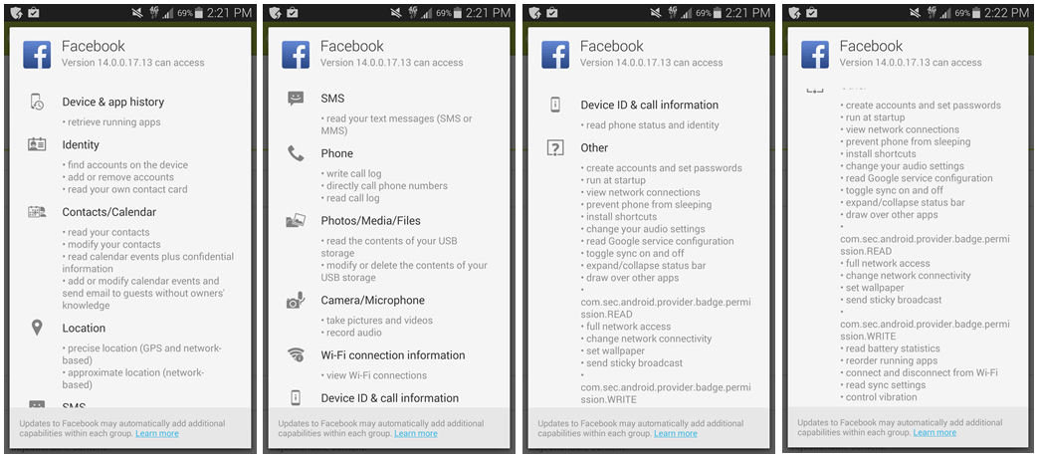
Notes:
This is a screenshot of permissions requested by Facebook, and as you can see a user can’t choose which permissions to grant, even though this includes a LOT of permissions.

Slide 6
Granting Permission- After Marshmallow
Installed application needs to access permission at runtime
“Normal” or “Dangerous”?
Normal Permissions Grant without notifying the user.
Dangerous Permissions
Completely new Popup notification appears requesting for permission
Another permission in the group has already been granted
Grant permission
Notes:
-Several problems with permissions fixed in Android version 6.0; Marshmallow
-Permissions can be granted at runtime, instead of install time and can be reverted later.
-Permissions have been divided into two categories; PERMISSION_NORMAL and PERMISSION_DANGEROUS.
-Normal permissions cover areas where the app needs to access data outside the applications' sandbox, but the risk to user privacy is low as defined by Android.
-These permissions are granted automatically by the application.
-Dangerous permissions on the other hand are further divided into classes.

Slide 7
Normal Permissions [4]
ACCESS_LOCATION_EXTRA_COMMANDS
ACCESS_NETWORK_STATE
ACCESS_NOTIFICATION_POLICY
ACCESS_WIFI_STATE
BLUETOOTH
BLUETOOTH_ADMIN
BROADCAST_STICKY
CHANGE_NETWORK_STATE
MODIFY_AUDIO_SETTINGS
NFC
READ_SYNC_SETTINGS
READ_SYNC_STATS
RECEIVE_BOOT_COMPLETED
REORDER_TASKS
REQUEST_IGNORE_BATTERY_OPTIMIZATIONS
REQUEST_INSTALL_PACKAGES
SET_ALARM
CHANGE_WIFI_MULTICAST_STATE
CHANGE_WIFI_STATE
DISABLE_KEYGUARD
EXPAND_STATUS_BAR
GET_PACKAGE_SIZE
INSTALL_SHORTCUT
INTERNET
KILL_BACKGROUND_PROCESSES
SET_TIME_ZONE
TRANSMIT_IR
UNINSTALL_SHORTCUT
USE_FINGERPRINT
VIBRATE
WAKE_LOCK
WRITE_SYNC_SETTINGS
Notes:
These are a list of permissions classified as “normal”. Risky :
ACCESS_WIFI_STATE CHANGE_NETWORK_STATE INTERNET REORDER_TASKS

Slide 8
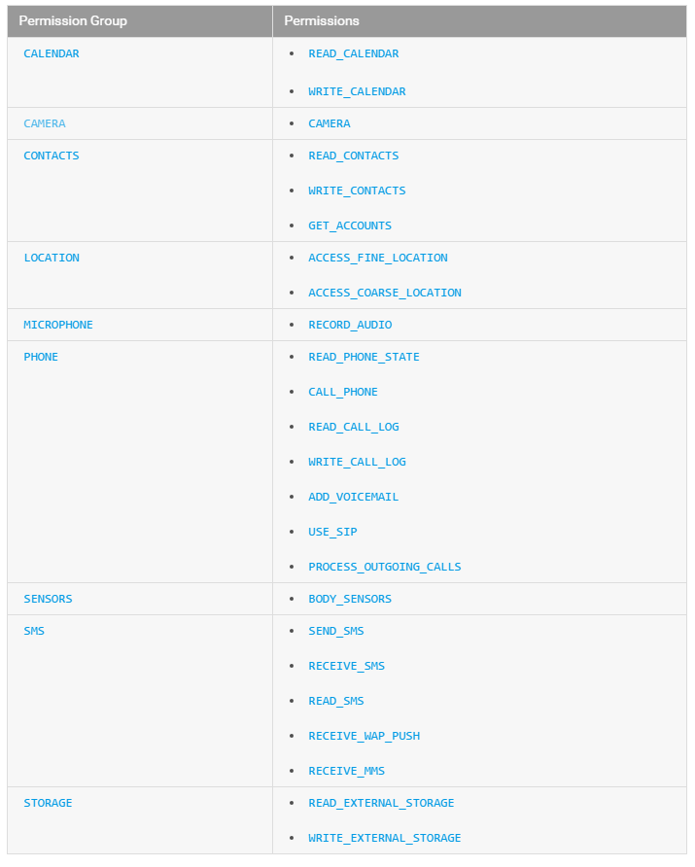
Dangerous Permissions[4]
Notes:
-When a ‘dangerous’ permission is requested if an app does not have any permissions in that group a runtime notification pops up where the user can choose to grant/revoke permission. If another permission in that group has already been granted, the app goes ahead and grants it without notifying the user.
-This is a set of dangerous permissions. As you can see READ_CONTACTS and WRITE_CONTACTS are in the same group. Therefore if an app requests WRITE_CONTACTS permission and READ_CONTACTS has already been granted, it will not notify the user.
Similarly permissions not listed here are classified as ‘Normal and granted automatically. These include:

Slide 9
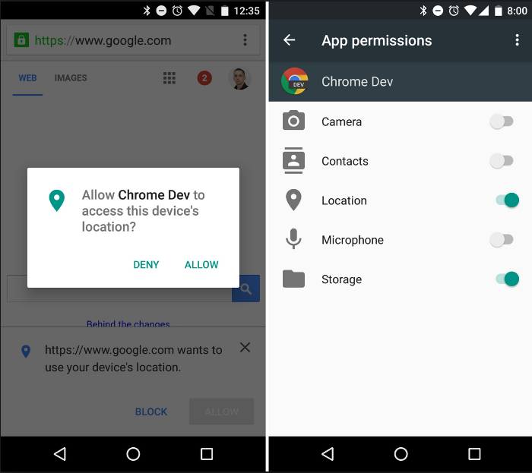
Notes:
This is a screenshot of Android requesting permissions at runtime on a device running Marshmallow. Permissions can be toggled after they have been granted.

Slide 10
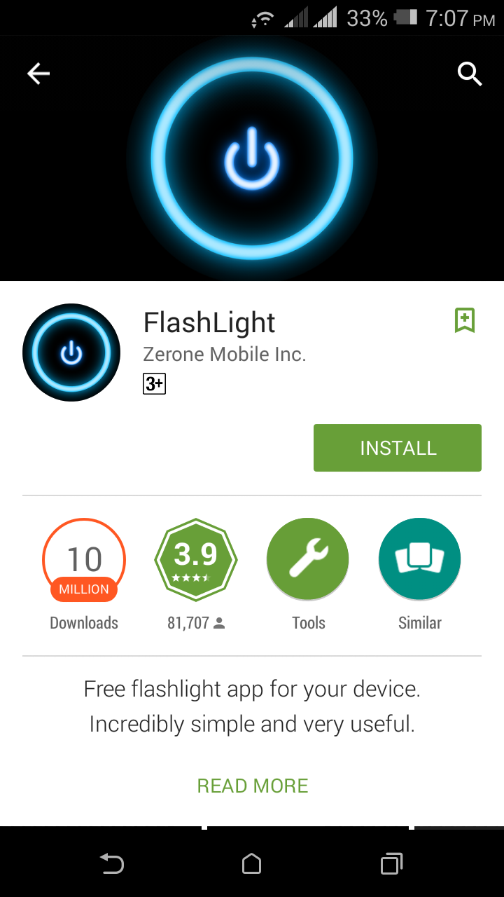
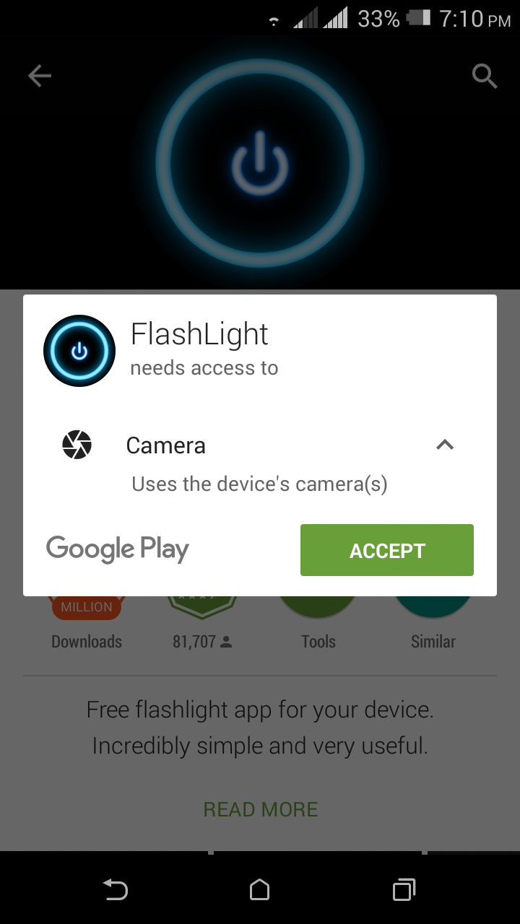
Problem? Unclear Permissions
Reasons for applications requesting permission left unexplained causing confusion [5]
Notes:
Main problem we will be addressing through this research is that permissions are still unclear.
-First time users when confronted with a list of permission to grant are confused, as there is no clear reason for granting certain permissions.
-For example in the screenshots above, a flashlight application requests access to the device’s camera. There is no further explanation, but experienced users would know that the camera permission also controls the flash, which is why the application is requesting it.

Slide 11

Problem? Unexpected Permission Access
Studies have shown that permission requests do not necessarily take place while the application is running visibly
Only 0.04% of location requests result in the GPS indicator appearing on the bar
Location accessed through cellular network, wifi state, browser data etc. These are not ‘dangerous’ permissions and are allowed[6]
Over 50% of applications that are granted location access later share the information with advertisers for targeted marketing[7]
Notes:
-Studies done in this area show that certain permission requests do not take place while the application is running. The time a permission is requested can tell us whether it’s legitimate. -For example the location icon is only on for 0.04% of location requests. And location can also be accessed through other permissions such as wifi state, bowser data, cellular network etc.
-this misused for target marketing

Slide 12

Problem? Legitimate Requests Denied
Some requests for legitimate permissions are not allowed because users assume it is a breach of privacy
AngryBirds WRITE_SMS permission denied by most users, resulting in new levels being inaccessible[8]
Google+ storage permission is denied by most users, resulting in thumbnails not being saved[9]
Notes:
-In an ideal situation a user should know why an application is requesting a particular permission; as part of its core functionality, secondary functionality, as a method of revenue generation
-People tend to base their decisions on the reason behind applications data access.
-However this is not possible with the current model
-Examples AngryBirds. Google+ -ANGRY BIRDS actually for billing in app purchases
-Applications functionality and revenue generation models can be affected due to permissions not being explained clearly.

Slide 13
Other problems?
Permission creep Applications require more permissions than are required, which can be exploited by other apps
Capability Leak(Permission re-delegation) Apps with permission provide service for underprivileged apps
Data remaining after uninstallation Uninstallation removes UID but not permission related data
Notes:
-Permission creep, which is application permissions being disallowed, even though they are necessary for the app to function
-Data residue attacks(life after uninstallation-data remains UIDs deleted)
-Capability leaks, where an app uses intents to exploit the permission granted to another application
- Permission re-delegation, when apps with permission provide services for underprivileged apps etc.

Slide 14






Research Goal
Propose and evaluate a user-driven privacy model to overcome the problems caused due to improper permission handling in android applications.
Notes:
Different types of interactions;
Users-apps to access functionality
Apps-kernel access data (this is where permissions are called on)
Apps-apps to interact communicate
-Users COULD interact with peers to share experience
How to use this to provide a more effective indicator of how privacy conscious an app is?

Slide 15
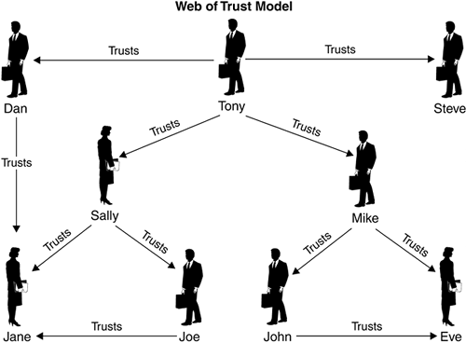
Web of Trust
Privacy is subjective and should be left for a user to decide
Central methods like ‘traditional’ malware reporting apps would not be ideal
Users will be given data based on peer experience through a web of trust based system
Other options will also be evaluated
Notes:
-This is where the Web of Trust comes in.
-Since privacy is subjective and the level of privacy needed for a user is left to be determined by the user himself, it would be insufficient to have a central method with ratings on how private an application keeps user data.
-Users while using the application get to know the level of privacy protection it offers.
-Web of trust, where users can access ratings based on peer experience would provide a solution.
-Deciding on a web of trust is not concrete, other options such as having something like a PKI based system will be evaluated as well.

Slide 16
Scope
Focused on Android running on smartphones
Apps downloaded from Google Play
Focus on privacy violations and not on malware detection/reporting
Free apps will be considered
Scope of application of the Web of Trust or evaluation method will be limited
Notes:
The research will focus on smartphones running the Android operating system. Free applications downloaded from Google Play will be considered during the time limit of the research. The scope and reach of the Web of Trust will be decided on during the research period.

Slide 17
Evaluation
The evaluation phase will consist of comparing the current model to the newly proposed model
Further methods for evaluation will be decided on during the research period
Notes:
No mathematical evaluation for privacy stuff cos it’s all subjective. Implement runtime prompts, for a set of users with WoT mechanism and for users that don’t and ask about sensitive requests, see how they react.

Slide 18
Related Work
Research focusing on malware detection, malicious application detection, virus protection for Android devices exist[10][11][12][13]
Research showing problems caused by the current permission model focus on capability leaks, permission creep, data residue attacks on uninstallation of apps, permission re-delegation, privacy breaches[14][15][16]
PGP models have been applied for Android message passing but not for application privacy[18]
Permission models have been proposed but not with the web of trust approach
Notes:
TaintDroid ScanDroid MalDroid etc. -In a privacy and security point of view, permissions once granted can be exploited.

Slide 19
References
[1] The android open source project. https://source.android.com/.
[2] Patterns: Permissions. https://www.google.com/design/spec/patterns/permissions.html#.
[3] Enck, William, Machigar Ongtang, and Patrick McDaniel. "Understanding android security." IEEE security & privacy 1 (2009): 50-57.
[4] Felt, Adrienne Porter, Kate Greenwood, and David Wagner. "The effectiveness of application permissions." Proceedings of the 2nd USENIX conference on Web application development. 2011.
[5] Felt, Adrienne Porter, et al. "Android permissions: User attention, comprehension, and behavior." Proceedings of the Eighth Symposium on Usable Privacy and Security. ACM, 2012.
[6] Wijesekera, Primal, et al. "Android permissions remystified: a field study on contextual integrity." 24th USENIX Security Symposium (USENIX Security 15). 2015.
[7] Saint, N. "50% of android apps with internet access that ask for your location send it to advertisers." (2010).
[8] A. Russakovskii. Rovio explains why the sms permission was introduced in angry birds v1.5.1. http://www.androidpolice.com/2011/02/06/rovio-explainswhy-the-sms-permission-was-introduced-in-angry-birds-v1-5-1/, 2011.
[9] "Some Android 6.0 Apps May Not Know to Ask for Permissions and Break." 2015. 4 May. 2016, http://lifehacker.com/some-android-6-0-apps-may-not-know-to-ask-for-permissio-1735380654.
[10] Aziz, Benjamin, and Mario Tejedor-Gonzalez. "An android PGP manager: towards bridging end-user cryptography to smart phones." International Journal of Security 6.5 (2012).4
[11] Enck, William, et al. "TaintDroid: an information-flow tracking system for realtime privacy monitoring on smartphones." ACM Transactions on Computer Systems (TOCS) 32.2 (2014): 5.[12]
[13] Rastogi, Vaibhav, Yan Chen, and William Enck. "AppsPlayground: automatic security analysis of smartphone applications." Proceedings of the third ACM conference on Data and application security and privacy. ACM, 2013.
[14] Grace, Michael C., et al. "Systematic Detection of Capability Leaks in Stock Android Smartphones." NDSS. 2012.
[15] Chan, Patrick PF, Lucas CK Hui, and Siu-Ming Yiu. "Droidchecker: analyzing android applications for capability leak." Proceedings of the fifth ACM conference on Security and Privacy in Wireless and Mobile Networks. ACM, 2012.
[16] Yang, Kun, et al. "IntentFuzzer: detecting capability leaks of android applications." Proceedings of the 9th ACM symposium on Information, computer and communications security. ACM, 2014.
[17] Vidas, Timothy, Nicolas Christin, and Lorrie Cranor. "Curbing android permission creep." Proceedings of the Web. Vol. 2. 2011.
[18] Aziz, Benjamin, and Mario Tejedor-Gonzalez. "An android PGP manager: towards bridging end-user cryptography to smart phones." International Journal of Security 6.5 (2012).4

Slide 20
Thank You! Questions?

Slide 21

Brief Introduction to Android[1]
Open Source Mobile OS currently owned by Google
Leading mobile OS with 29.3% popularity over iOS
Currently on version 6.0(Marshmallow)
Applications can be installed from Google PlayStore
Permissions should be granted for apps to access sensitive resources
Developers required to specify permissions in the Android Manifest
Notes:
-Mobile OS comparatively new. No defined security and privacy models as for ‘traditional’ OS
-Smartphone privacy hot issue recently due to security and privacy leakages
-Brief Intro
-Android is open source mobile OS first developed by independent company Android Inc, acquired by Google in 2005
-Leading mobile OS, competitors: iOS, Windows, Blackberry Symbian
-Versions traditionally named after desserts alphabetically, and current version 6.0 marshmallow(SDK 23) Software Development Kit
-Applications by 3rd parties and Google itself downloadable from Google Play
-Users have to grant permission for apps to access certain resources
-Developers when uploading specify these in Android Manifest (xml file that should be present in root directory. Essential info about app to Android system)

